Slide 1


EarlyCare Gateway
A Microservices Architecture for Clinical Decision Support
with Explainable AI
Supervisor:
Prof.ssa Marina Mongiello
Group 9:
Roberto Carriero
Luca Cianci
Luca Serio
Software Architecture and Pattern Design
A.Y. 2025/2026

Slide 2



Who We Are
Roberto Carriero
Luca Serio
Luca Cianci
Group 9 - EarlyCare Gateway
A.Y. 2025/2026

Slide 3

Introduction
Problem
The current triage process is inefficient:
Shortage of healthcare staff
High patient inflow
Slow and redundant decision-making processes
Consequence
Delays, errors, stress for medical staff
→ Deterioration of the patient experience
Group 9 - EarlyCare Gateway
1

Slide 4

Introduction
Solution
Intelligent analysis platform for doctors
→ Provides diagnoses and supports decisions
Key Features
Explainable AI: Multimodal analysis with explanations
Distributed Architecture: Remote private and secure access
Clinical Dashboard: Interface to manage analysis and reports
Group 9 - EarlyCare Gateway
2

Slide 5

Functional Requirements
Medical Staff Management: Authentication and authorization
Explainable AI Analysis: Submission of clinical data for AI-based classification, and generation of explainable reports
Persistent Report Management: Viewing doctor reports and filtering by patient
Audit and Monitoring: Logging of all events
Only authorized medical staff
Group 9 - EarlyCare Gateway
3

Slide 6

Non-Functional Requirements
Privacy and Security: Anonymization of sensitive data (SHA256), authentication with JSON Web Tokens (JWT)
Traceability and Audit: Asynchronous logging
Configurable Response Times: Runtime choice between faster or more accurate AI models (Swappable AI)
Scalability and Maintainability: Containerized microservices architecture, RESTful APIs, database-per-service
Group 9 - EarlyCare Gateway
4

Slide 7
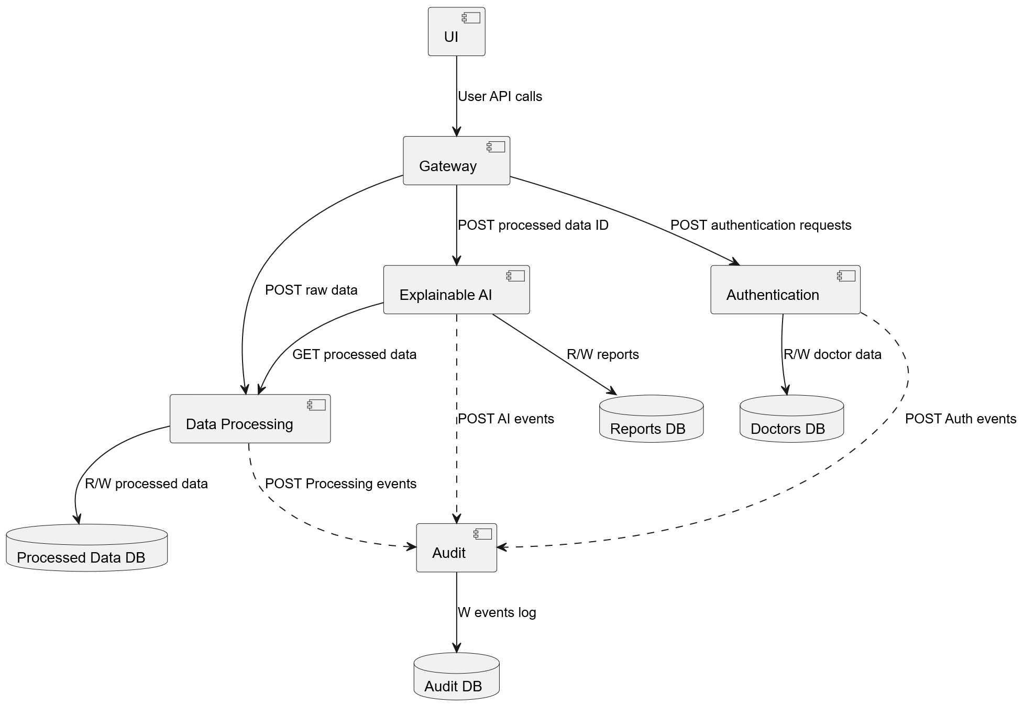
Architecture
UML Diagram
Components
Group 9 - EarlyCare Gateway
5

Slide 8

Design Patterns
Each service is associated with at least one design pattern
Gateway: Facade
Authentication: Repository, Observer (Subject)
Data Processing: Chain of Responsibility, Repository, Observer (Subject)
Explainable AI: Strategy, Repository
Audit: Observer, Repository
Group 9 - EarlyCare Gateway
6

Slide 9

Application Programming
Interface (API)
Public endpoints
POST /register: Allows medical staff registration
POST /login: Authenticates the user and generates a JWT token, required for protected endpoints
Group 9 - EarlyCare Gateway
7

Slide 10

Application Programming
Interface (API)
Protected endpoints
POST /analyse: Runs data processing and XAI analysis to obtain a diagnosis
GET /reports: Allows authenticated doctors to retrieve all generated reports or filter by a specific patient
Group 9 - EarlyCare Gateway
EarlyCare Gateway
8
8

Slide 11
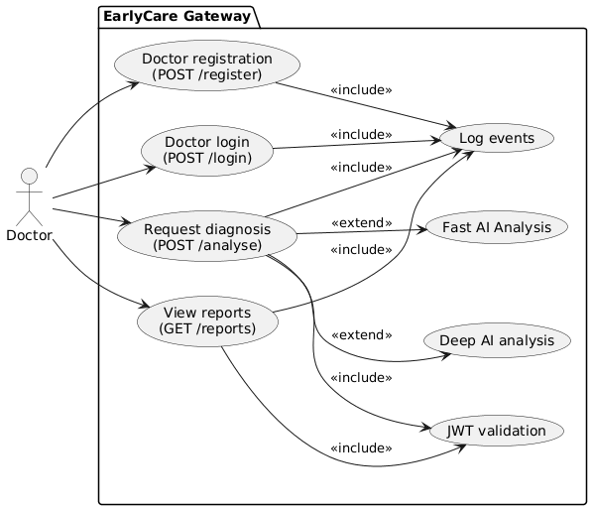
Use Case
UML Diagram
Use Case
Entities
Microservices System
Doctor (Actor)
Group 9 - EarlyCare Gateway
EarlyCare Gateway
8
9

Slide 12






Technology Stack
Agile: Kanban
Task Planning: Gantt charts
Communication: Microsoft Teams
Version Control: Git/GitHub
Containerization and Deployment: Docker, Docker-Compose
Development and Testing: Python (FastAPI), PostgreSQL, React
Group 9 - EarlyCare Gateway
EarlyCare Gateway
8
10

Slide 13

User Interface
React Components and Pages (styled with Tailwind CSS)
Authentication: Enables doctors to create an account or sign in if already registered
Diagnostic Hub: Core of the system, allows performing analyses by entering the raw data and fiscal code on specific tab
Reports History: Allows doctors to view reports associated with them, optionally filtering by a specific patient
Group 9 - EarlyCare Gateway
EarlyCare Gateway
8
11

Slide 14

Databases
doctors: id, name, surname, email, hashed_password
processed_data: id, type, data, created_at
reports: id, doctor_id, patient_hashed_cf, processed_data_id, created_at, strategy, explanation
logs: id, created_at, event, doctor_id, patient_hashed_cf, data_id, report_id
Group 9 - EarlyCare Gateway
EarlyCare Gateway
8
12

Slide 15
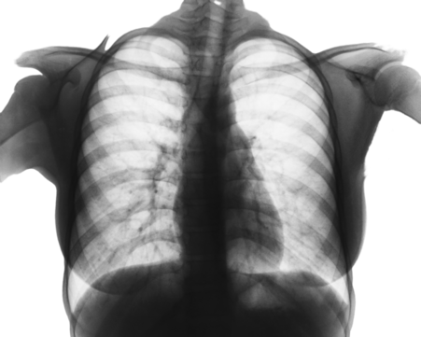
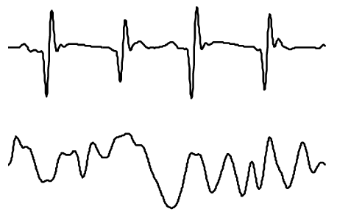
AI Strategies
Textual Data: ClinicalBERT
Imaging Data (CNN): CheXNet (X-Ray), DenseNet (Skin Lesions)
Structured Numeric Data: XGBoost
Signal Data: Gemini 2.5 Flash-Lite API
Group 9 - EarlyCare Gateway
EarlyCare Gateway
8
13

Slide 16
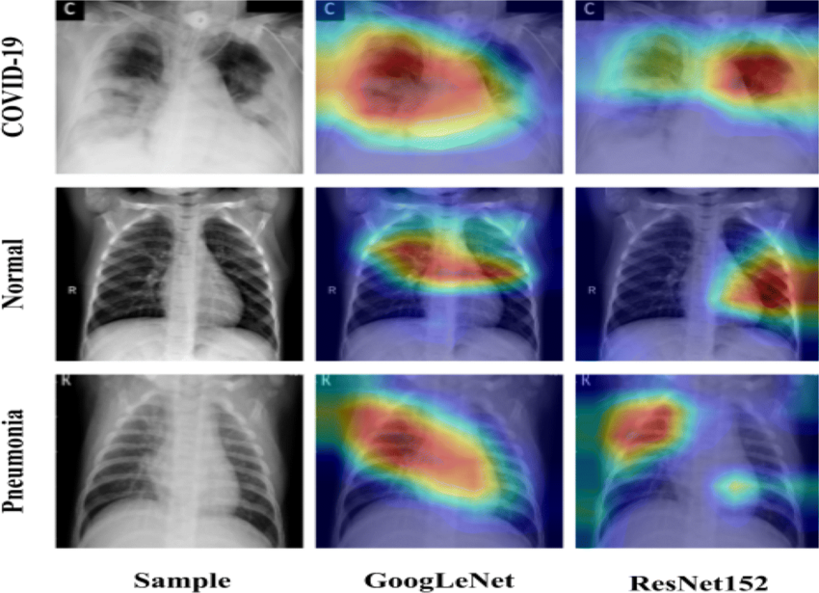
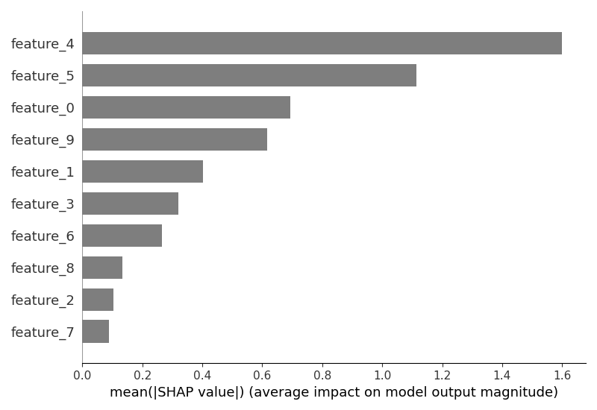
Explainable AI
Textual/Signal Analysis: Gemini 2.5 Flash-Lite API
Imaging Data (CNN): Grad-CAM
Structured Numeric Data: SHAP
Group 9 - EarlyCare Gateway
EarlyCare Gateway
8
14

Slide 17

Results
Microservices Integration Test: Fully automated testing pipeline using pytest.
AI Models Metrics
ClinicalBERT: Accuracy = 88%
CheXNet: Mean AUC = 0.837
EfficientNet: Accuracy = 88%
XGBoost: Accuracy = 82.1%
Group 9 - EarlyCare Gateway
EarlyCare Gateway
8
15

Slide 18
Future Developments
Clinical Interoperability: Integration of HL7/FHIR protocols for direct connection with Hospital Information Systems
AI Evolution: Adoption of 1D-CNNs for advanced morphological analysis of ECG signals
Medical Feedback: Q&A mechanism for continuous model re-training
Infrastructure Scalability: Migration from Docker Compose to Kubernetes for auto-scaling and transition to Message Broker for complete asynchronous event-driven microservices architecture
Group 9 - EarlyCare Gateway
EarlyCare Gateway
8
16

Slide 19
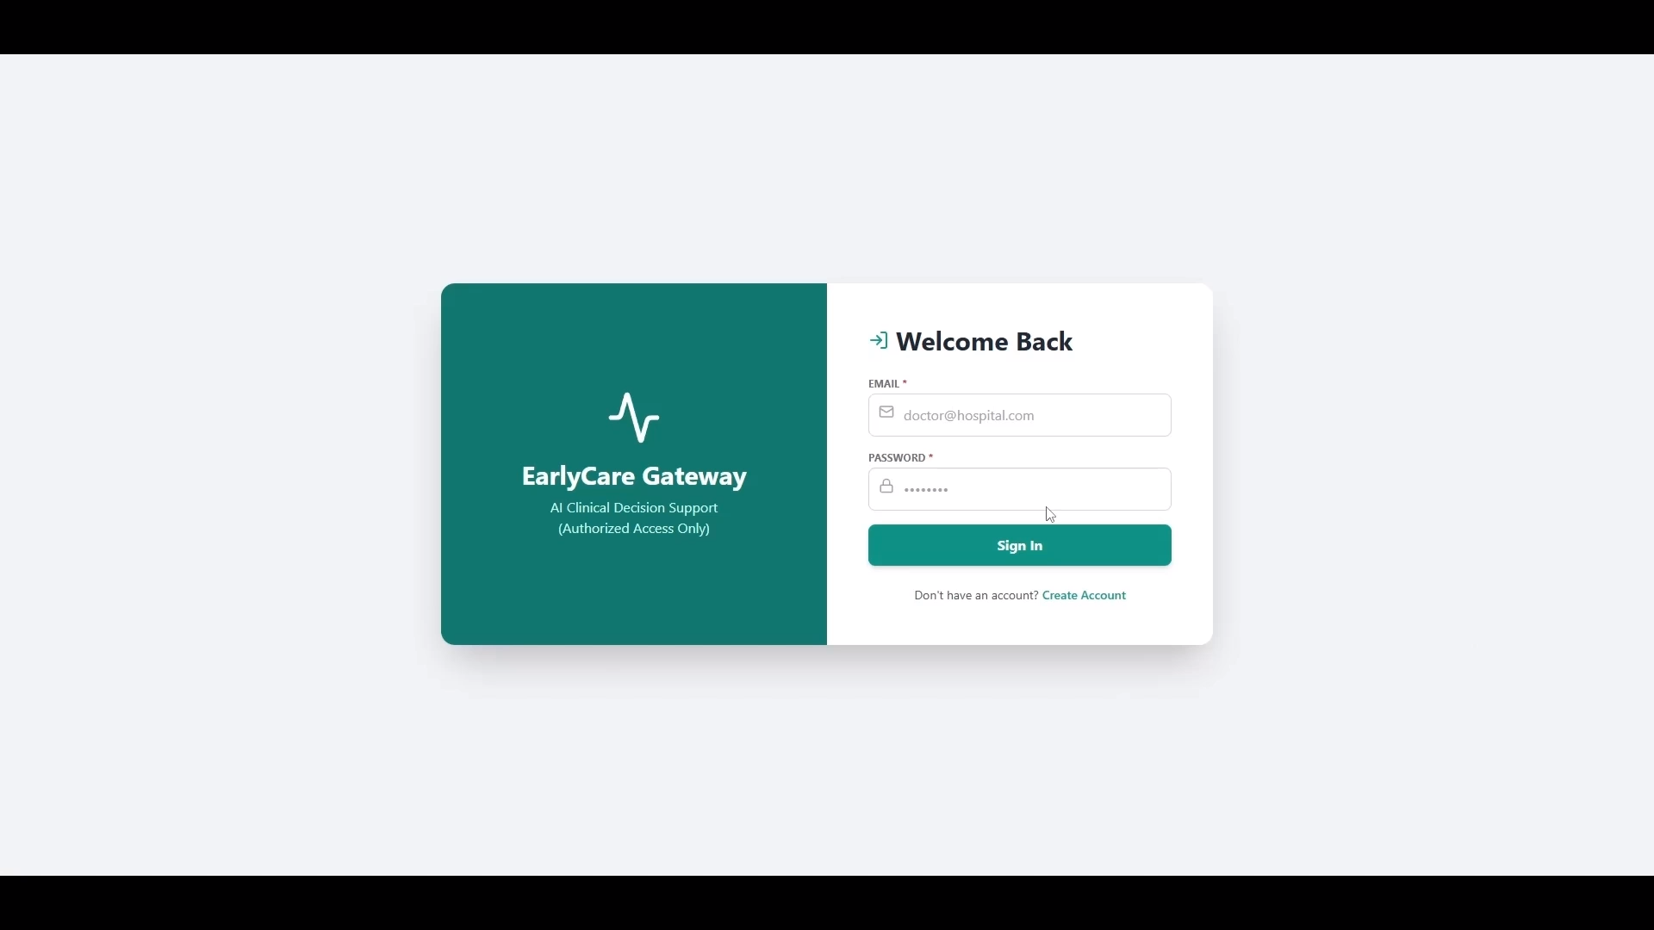
Group 9 - EarlyCare Gateway
A.Y. 2025/2026

Slide 20
Thank you for your attention!
Software Architecture and Pattern Design
A.Y. 2025/2026

